Slide 1
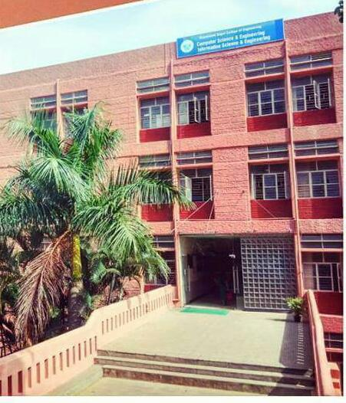

Slide 2
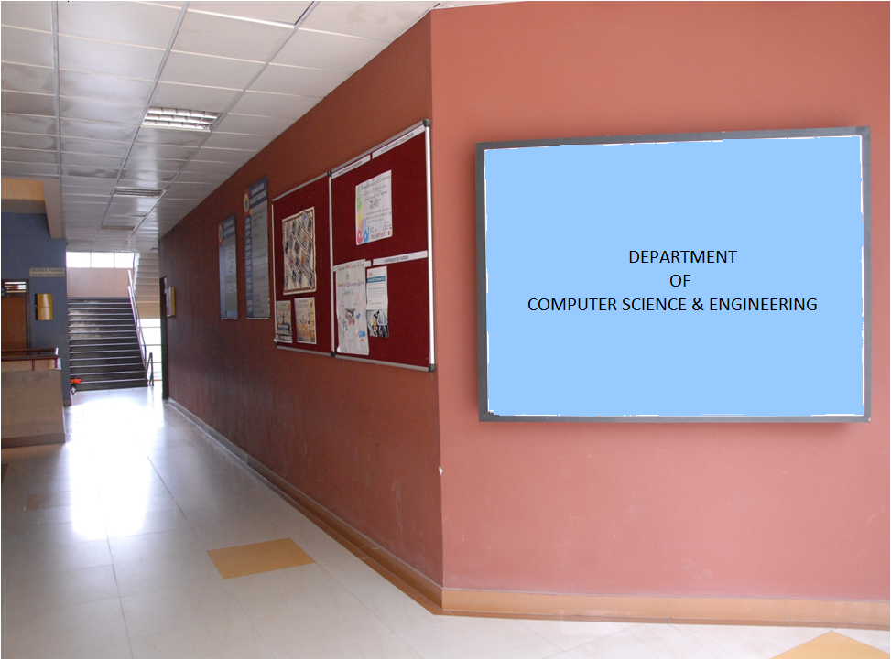

Slide 3

Stop and wait ARQ (Automatic repeat request) protocol
The sender node transmits one frame packet and waits for an acknowledgment (ACK) from the receiver.
Until it receives an ACK, sender will not transmit the next frame thereby maintaining the order of frames.
If ack is lost, the frames are resent once again when the timer times out. Hence, the name Stop & wait Automatic repeat request protocol
DAYANANDA SAGAR COLLEGE OF ENGINEERING

Slide 4

DAYANANDA SAGAR COLLEGE OF ENGINEERING

Slide 5
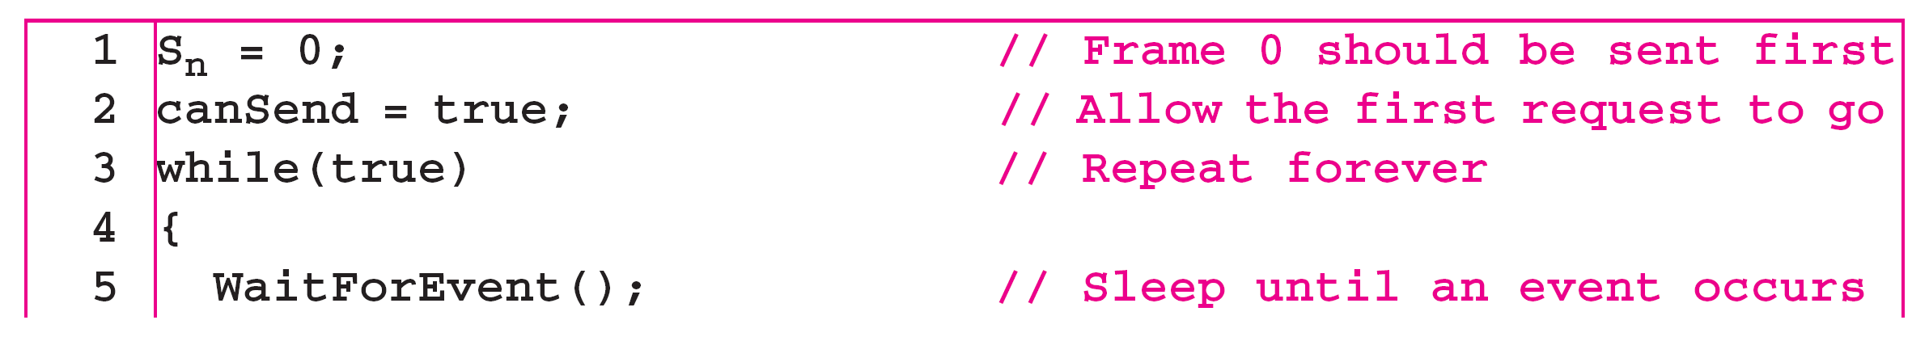
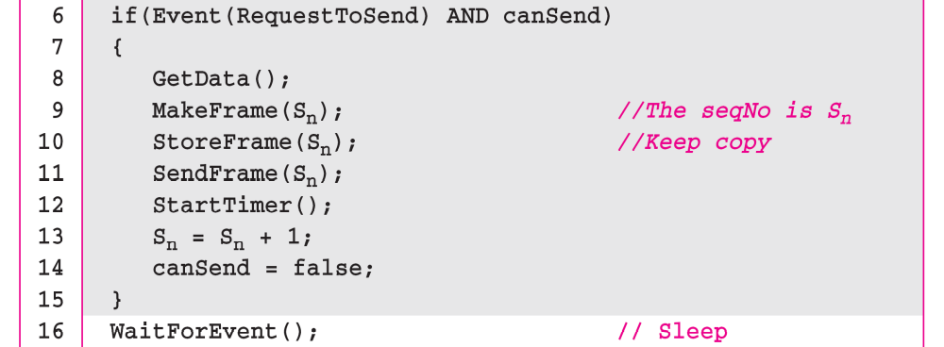
Algorithm Sender-side algorithm for Stop-and-Wait ARQ
_{(continued)}
11.<number>

Slide 6
Algorithm 11.5 Sender-site algorithm for Stop-and-Wait ARQ
11.<number>

Slide 7
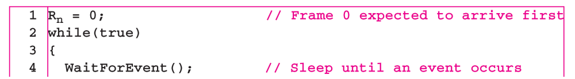
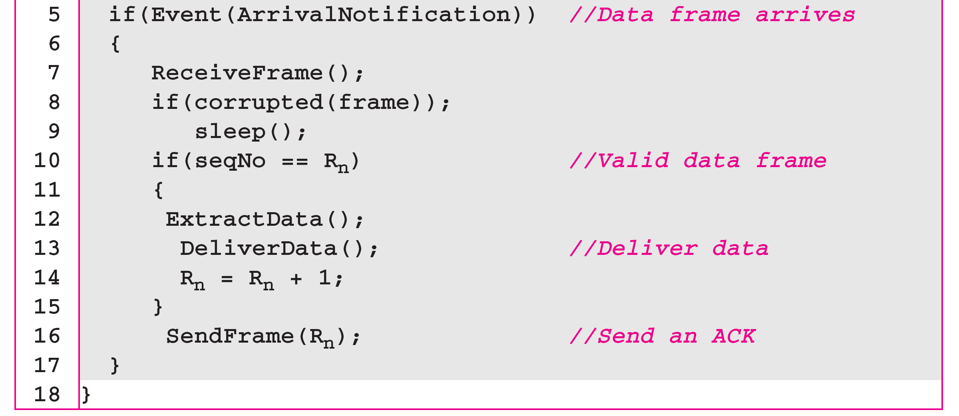
Algorithm Receiver-side algorithm for Stop-and-Wait ARQ Protocol
11.<number>

Slide 8
Sample Output 1 :
SENDER : Info = 1 seq No = 0
error rate = 1 RECIEVER :Packet 1 recieved , Ack Sent
error rate = 1 SENDER : Info = 2 seq no = 1
error rate = 0 RECIEVER : Corrupted Frame
SENDER : Ack not recieved=> TIMEOUT
SENDER : Resending Frame
error rate = 1 RECIEVER :Packet 2 recieved , Ack Sent
error rate = 1 SENDER : Info = 3 seq no = 0 error rate =1
RECIEVER :Packet 3 recieved , Ack Sent
DISCONNECTED
DAYANANDA SAGAR COLLEGE OF ENGINEERING

Slide 9
Sample Output 2
SENDER : Info = 1 seq no = 0
error rate =1
RECIEVER :Packet 1 recieved
ACK SENT 1
error rate =2
SENDER : Info = 2 seq no = 1
error rate =3
RECIEVER :Packet 2 recieved
ACK SENT 0
error rate =0
SENDER : Ack not recieved=> TIMEOUT
SENDER : Resending Frame
error rate =1
RECIEVER : Duplicate Frame.... Acknowledgement Resent
error rate =2
SENDER : Info = 3 seq no = 0
error rate =3
RECIEVER :Packet 3 recieved
DISCONNECTED
ACK SENT 1
error rate =0
DAYANANDA SAGAR COLLEGE OF ENGINEERING

Slide 10

SENDER : Info = 1 seq no = 0
error rate =1
RECIEVER :Packet 1 recieved
ACK SENT 1
error rate =2
SENDER : Info = 2 seq no = 1
error rate =0
RECIEVER : Corrupted Frame
SENDER : Ack not recieved=> TIMEOUT
SENDER : Resending Frame
error rate =1
RECIEVER :Packet 2 recieved
DISCONNECTED
ACK SENT 0
error rate =2

